Slide 1
IOT 4117: IoT Architecture and Technologies
Md. Habibur Rahman
Lecturer
Department of ICT, BDU

Slide 2

Chapter 20
Network Layer:
Internet Protocol
Copyright © The McGraw-Hill Companies, Inc. Permission required for reproduction or display.

Slide 3
20-4 TRANSITION FROM IPv4 TO IPv6
Because of the huge number of systems on the Internet, the transition from IPv4 to IPv6 cannot happen suddenly. It takes a considerable amount of time before every system in the Internet can move from IPv4 to IPv6. The transition must be smooth to prevent any problems between IPv4 and IPv6 systems.
Topics discussed in this section:
Dual Stack Tunneling Header Translation

Slide 4
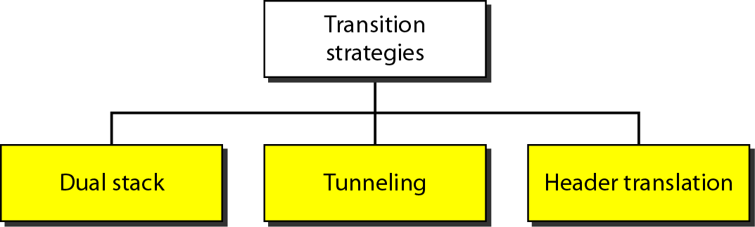
Figure 20.18 Three transition strategies

Slide 5
Dual Stack
All hosts before complete migration from IPv6 to IPv4 must have a dual stack of protocols.
A station must run IPv4 and IPv6 simultaneously.
To determine which version a destination host is using, the source host queries the DNS.
If the DNS returns an IPv4 address, the source then send IPv4 packets.
If the DNS returns an IPv6 address, the source then send IPv6 packets.

Slide 6
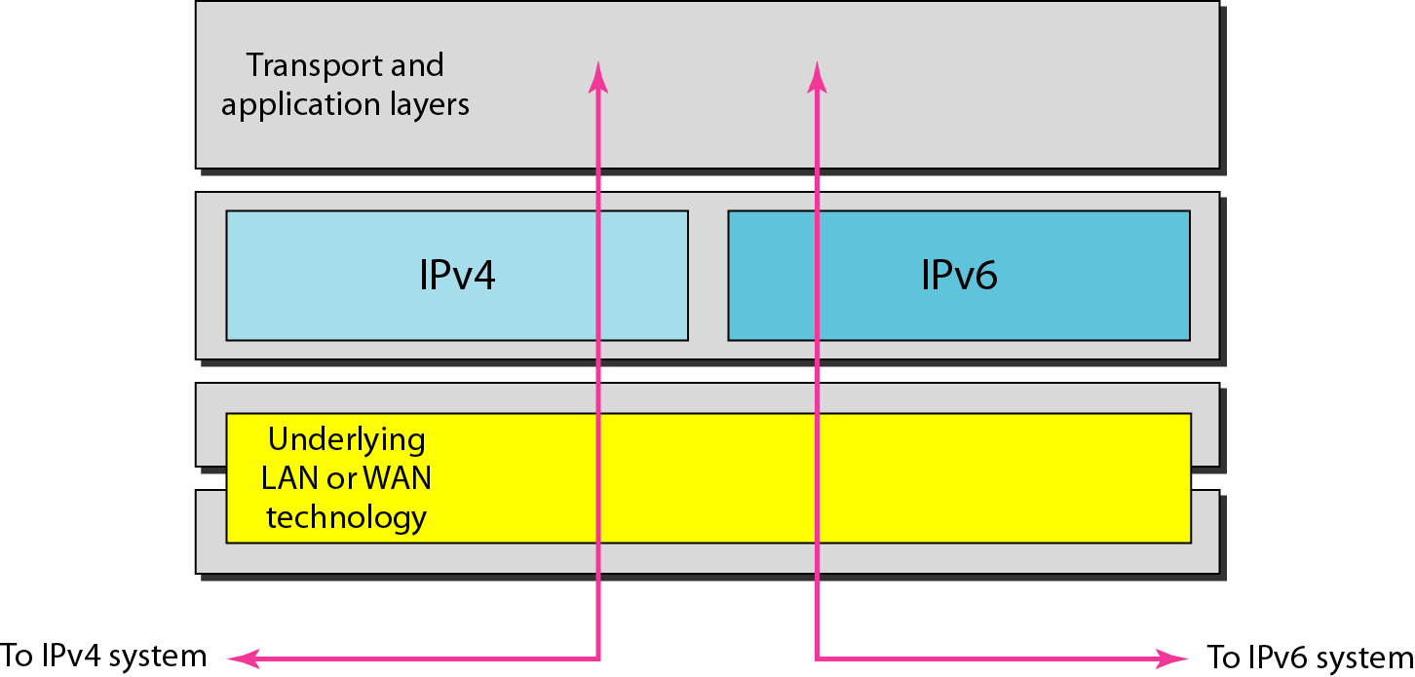
Figure 20.19 Dual stack

Slide 7
Tunneling
It is a mechanism used when both sender and receiver hosts use IPv6 but in between a region falls that uses IPv4.
To pass through this region the IPv6 packet is first encapsulated in IPv4 Header and after coming out this header is removed.
The field ‘protocol’ in IPv4 has value 41 when the data it contains is an IPv6 Packet.

Slide 8
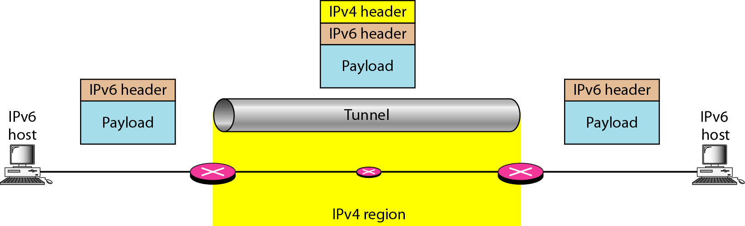
Figure 20.20 Tunneling strategy

Slide 9
Header Translation
In this case the header of IPv6 is completely changed in IPv4 header.

Slide 10
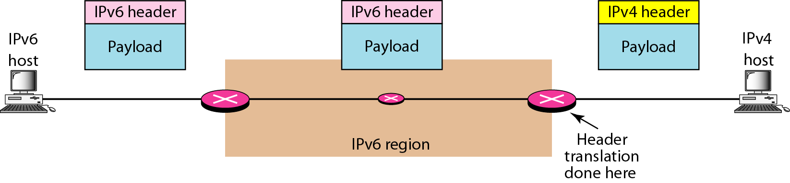
Figure 20.21 Header translation strategy

Slide 11
Table 20.11 Header translation

